Slide 1







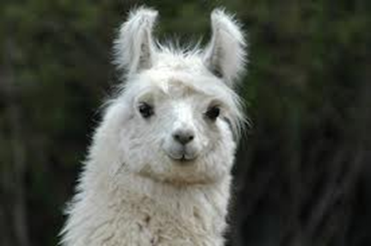
LLAMA
Large Latin American Array
SPANET Workshop September 2017

Slide 2
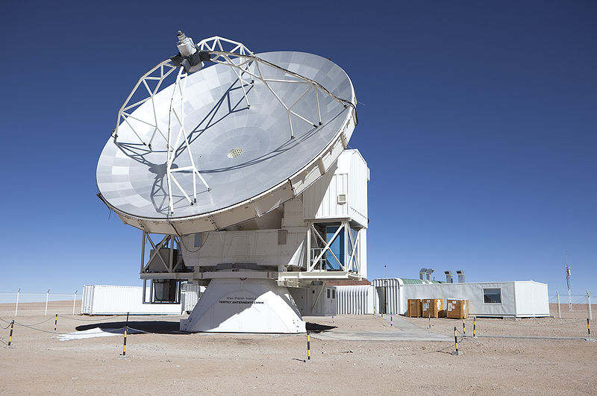
LLAMA
12 m diameter
4800 m altitude
In one year we will look like APEX

Slide 3
Radiotelescopes above 4000 m
competitiveness
ALMA
x 12m antennas Chajnantor 5000 m Chile USA, ESO, Japan/Taiwan
APEX 12m Chajnantor 5000 m Chile Sweden, Germany, ESO
ASTE 10 m Pampa la Bola 4800 m Chile Japan
JMCT + SMA 15 m
+ 8 x 6m Mauna Kea 4100 m USA East Asian Observatory
LLAMA 12m Chorillos 4800 m Argentina Argentina+ Brazil
The only single dish able to observe the Sun
LMT 50 m Sierra Nevada 4600 m Mexico Mexico, USA
NANTEN 2 4m Chajnantor 4865 m Chile Japan, Korea

Slide 4
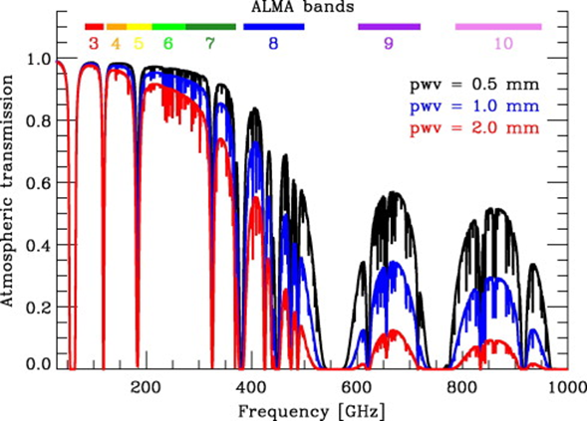
Why altitude is important?
LLAMA
LLAMA

Slide 5
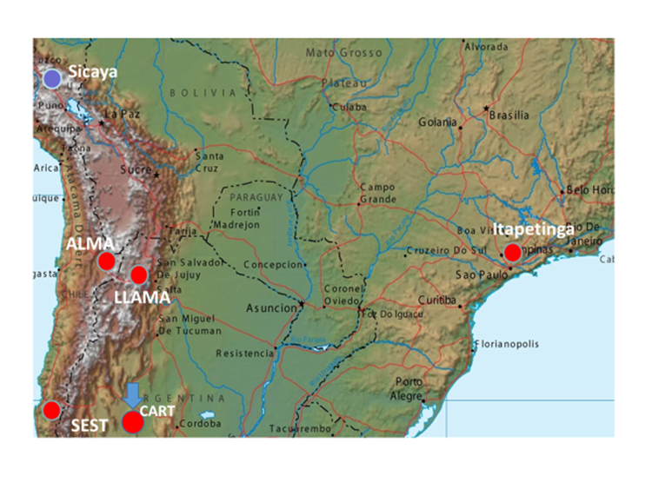

Slide 6
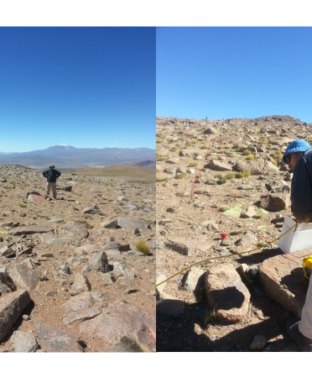
The future place of the antenna
Characteristics
4800 m altitude
About 150 km from ALMA
12m diameter
20 microns surface accuracy approx.
High technology cooled (4 degrees K) receivers

Slide 7
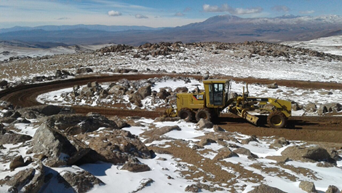
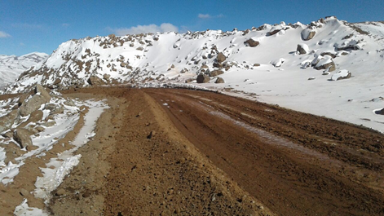
The road

Slide 8
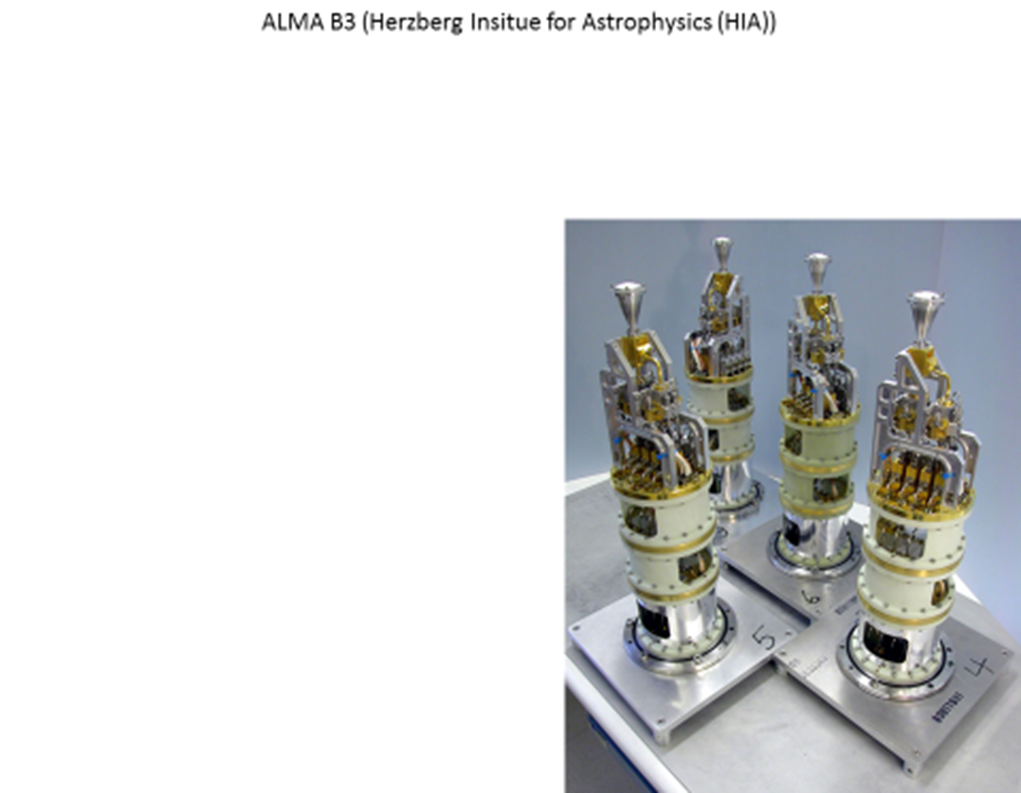
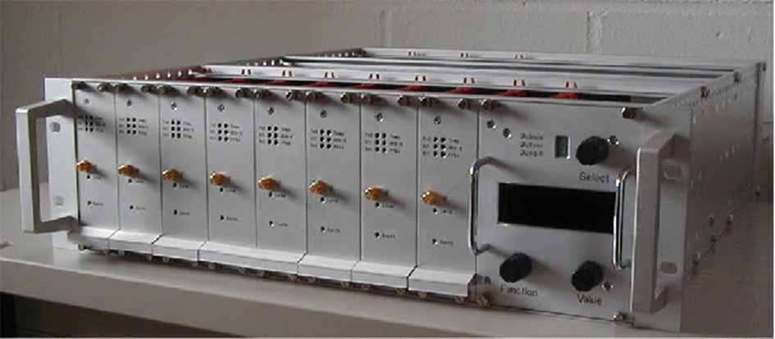
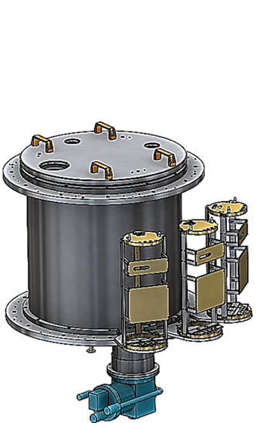
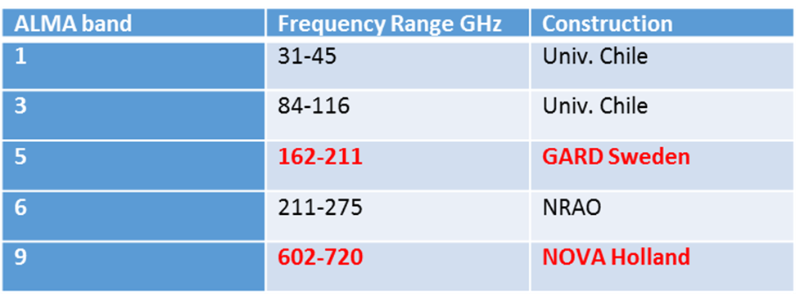
Cooled receivers – state of the art
First 2 receivers + first cryostat will be provided by international collaborations NAOJ (Japan) NOVA (Netherlands) and Chalmers Univ. (Sweden)
Integration and test of the 2 receivers in 2017 (band 5 and band 9) made at NOVA Groningen.
Training of 2 engineers (Escola Politécnica)
In April 2017 a software engineer went there
Receivers
spectrometer
cryostats

Slide 9
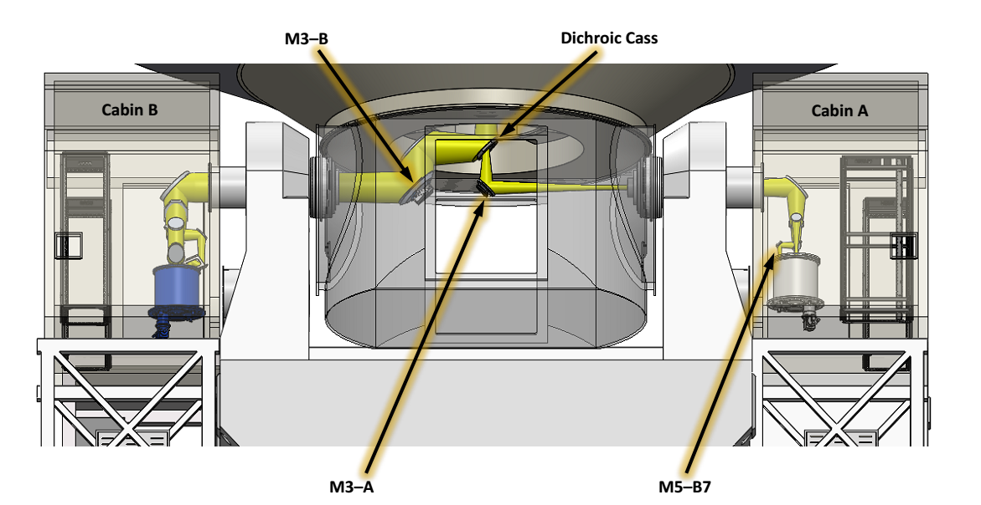
Antenna with excellent availability of space for instruments and experiments
for new developments
The “optical” path, set of mirrors to bring the beam to the receivers

Slide 10
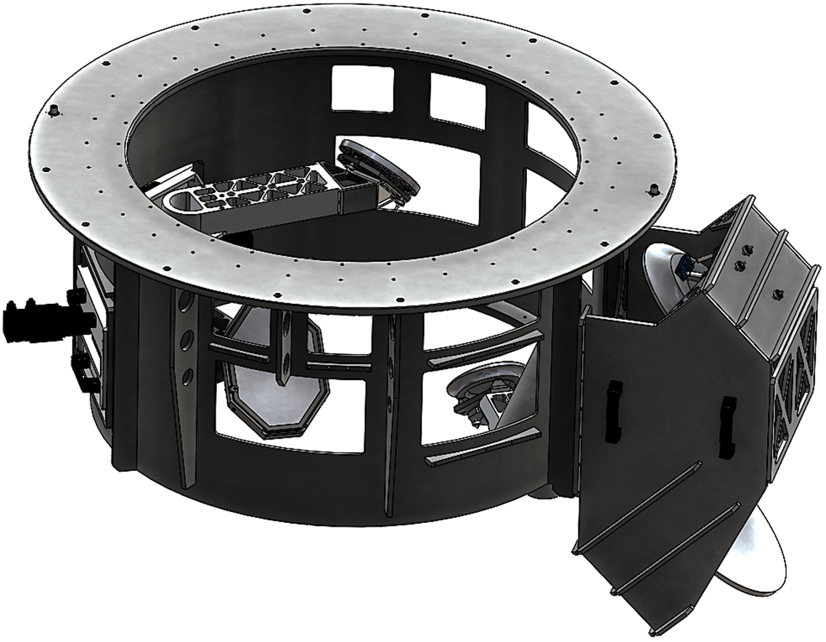
FIlling the cabins of the antenna: optical sytem designed
by Fernando Santoro - USA

Slide 11
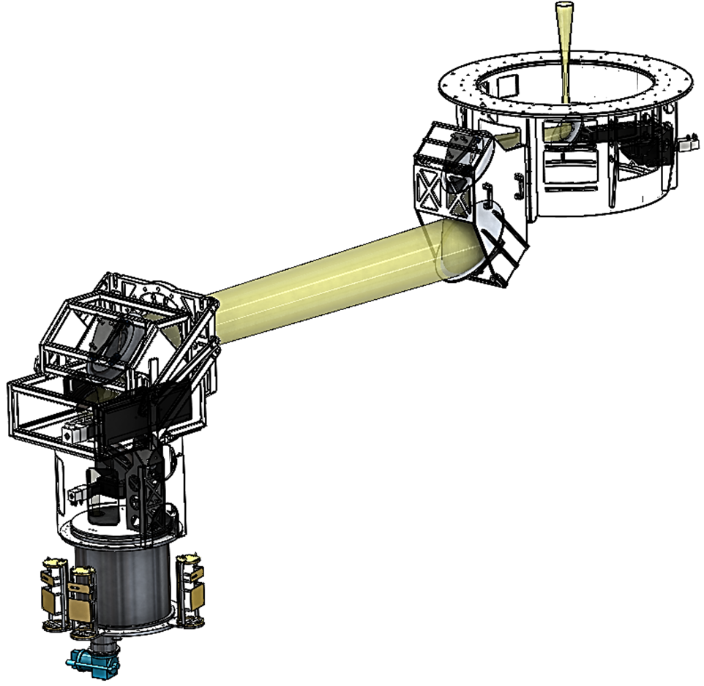
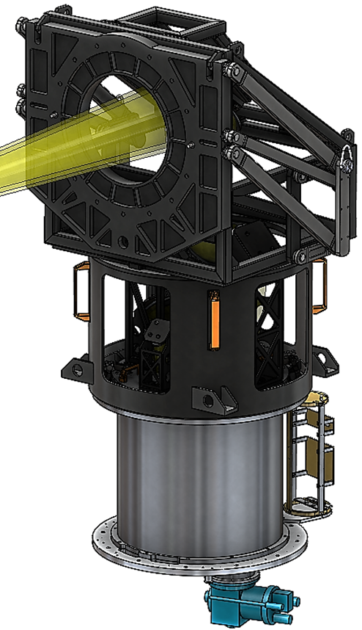
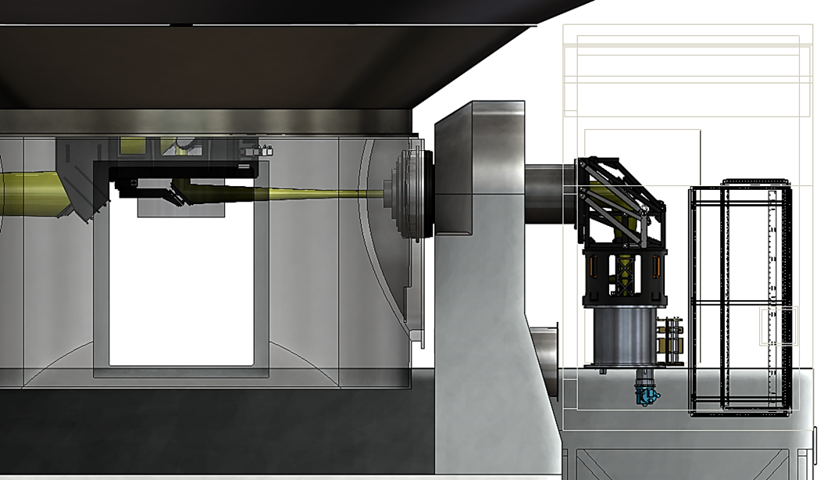
Conceptual design of system of mirrors,
Support of cryostat going on

Slide 12
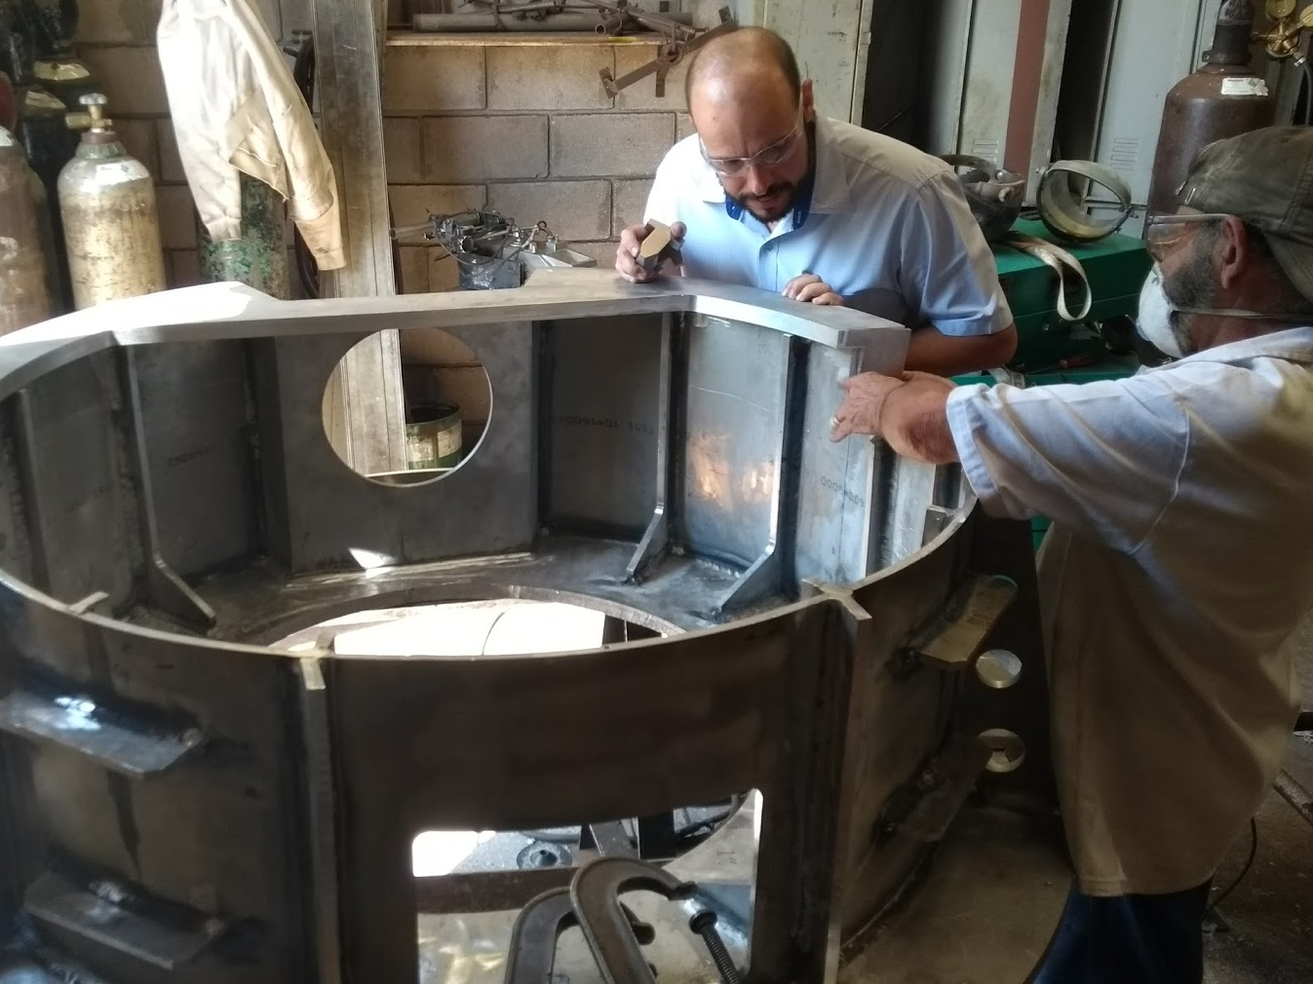
Construction going on in Araraquara, São Paulo State

Slide 13
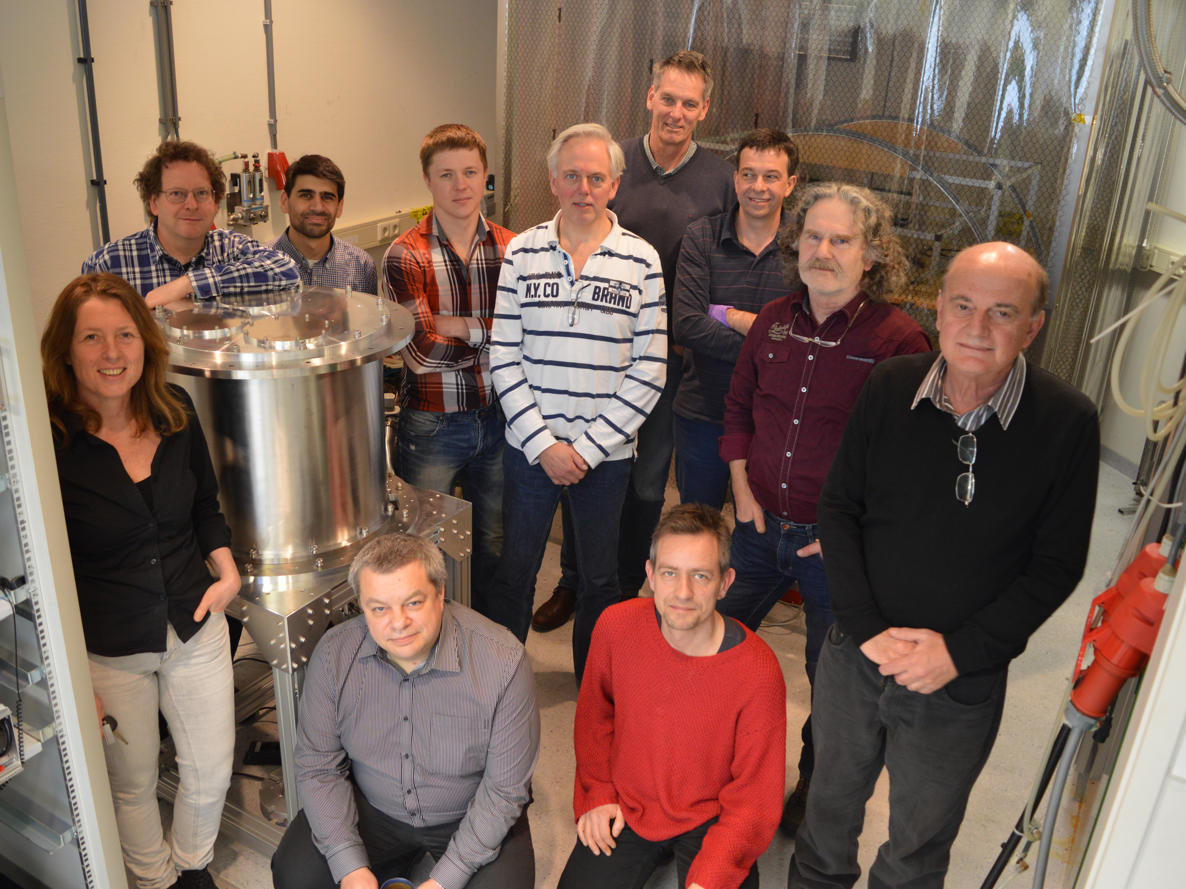
Team at NOVA

Slide 14
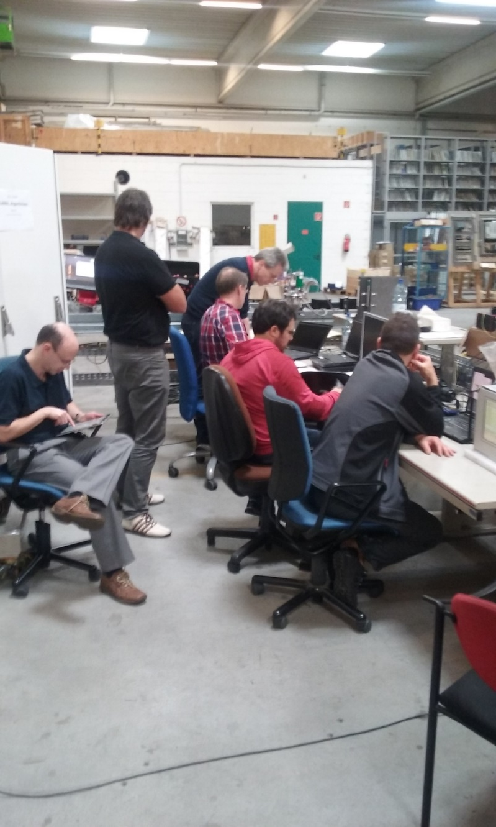
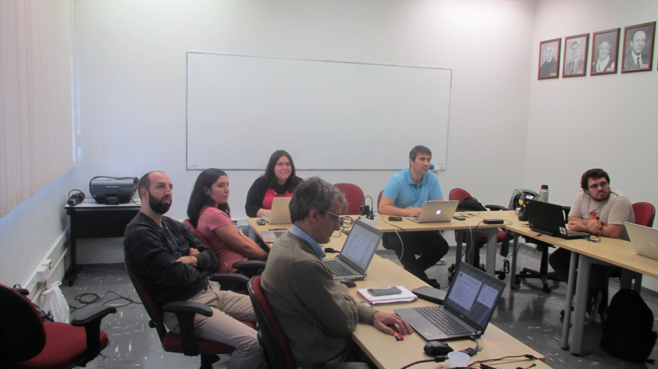
Software team at work
At VERTEX (Duisburg,
Germany, testing
Commands of antenna
May 25, 2016
At IAG- São Paulo, May 2016,
With participation of 3 Chileans

Slide 15
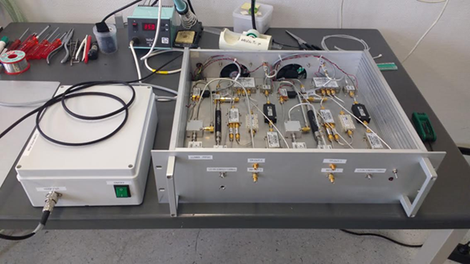
Prototype IF processor mounted at NOVA

Slide 16
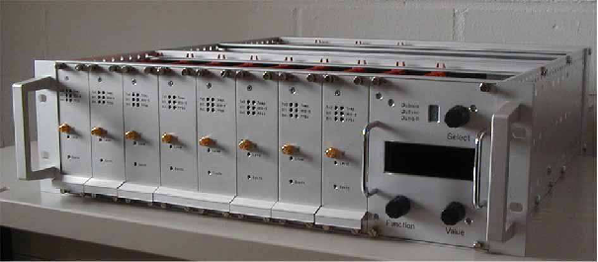
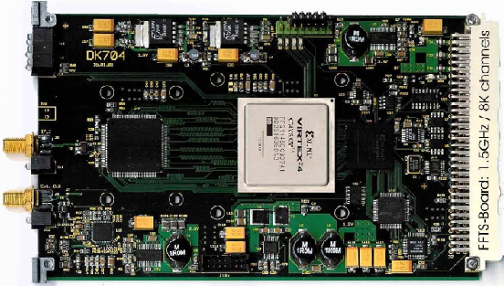
Fast Fourier Transform Spectrometer (RPG)
19” crate with 8 FFTS boards and 1 controller
Signal Input: DC - 1.5 GHz
ADC: 8 bit
DSPL Polyphase filter bank (FFT)
Resolution: 212 KHz @1.5 GHz BW
Channel spacing 183 KHz
Spectral Channels: 8192 (8K) @1.5 GHz BW

Slide 17
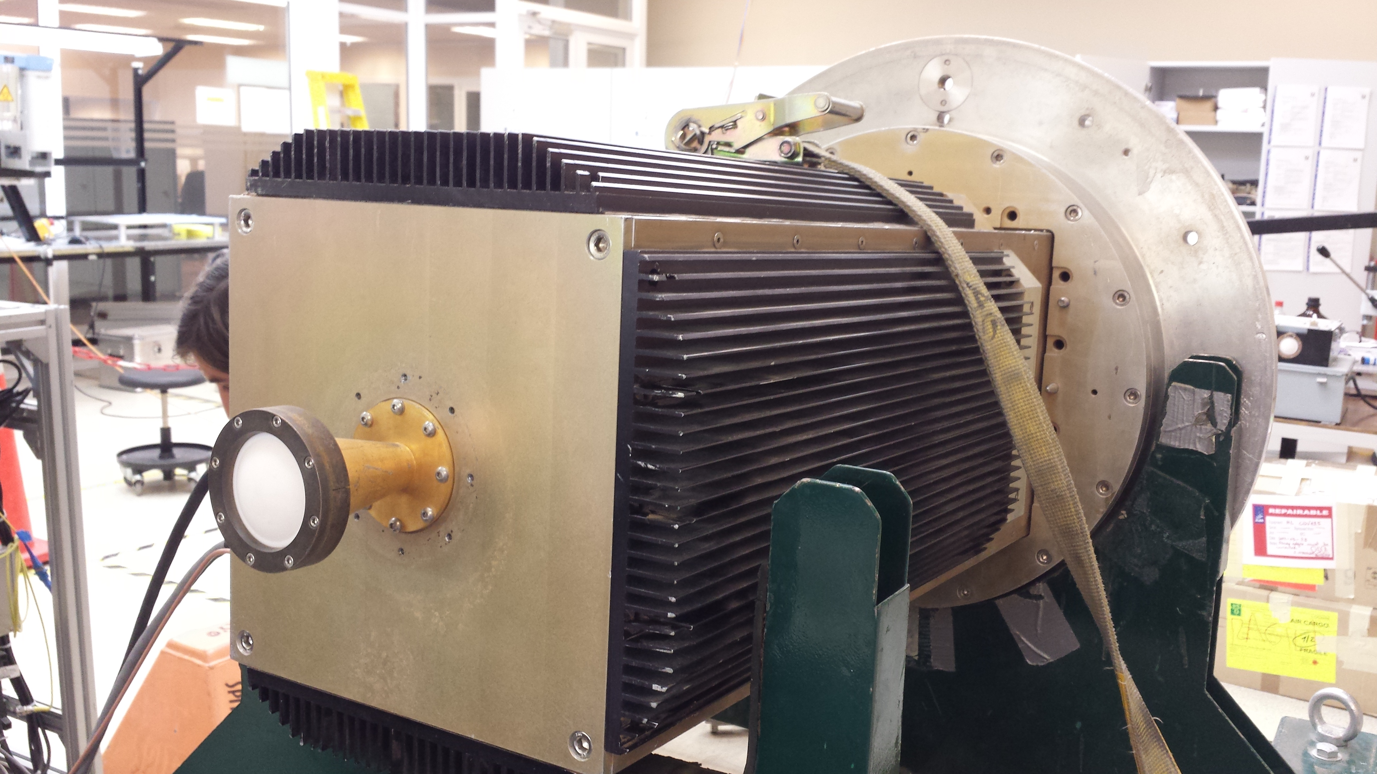
Holographic receiver belonging to ALMA

Slide 18
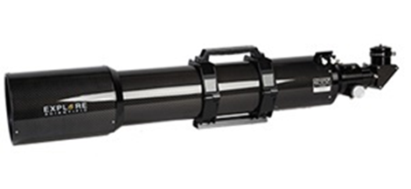
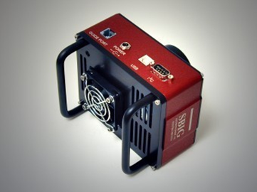
Optical Telescope for pointing

Slide 19
LLAMA scientific objectives
VLBI images of regions a few times the horizon size of super- massive black holes (e.g. Sgr A*, Cen A, etc.).
Event Horizon Telescope Several mm radiotelescopes with Thousand km separations to observe the Black Hole of our Galaxy
Galaxy Formation in the Early Universe
Extragalactic megamasers of water molecules
Masers of recombination lines of the hydrogen atom.
Astrochemistry: molecular evolution of interstellar clouds
Spiral structure of the Galaxy and other galaxies
Molecular absorption in front of quasars at very high Zs
Non-thermal processes in stellar magneto-spheres
Extra-solar planets and proto-planetary disks
Polarimetry of radio sources and of the Interstellar Medium
Solar Physics

Slide 20
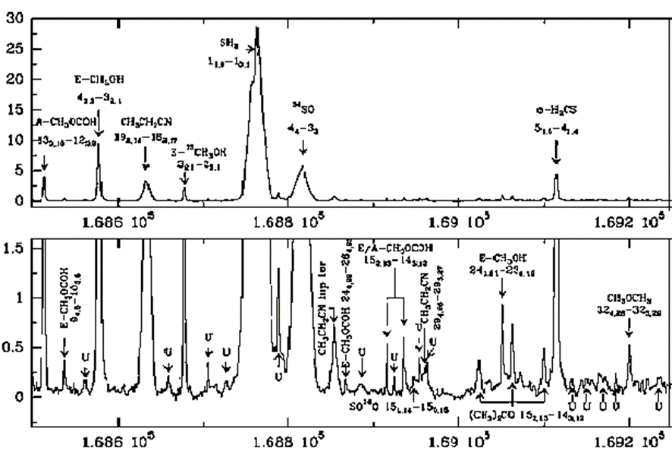
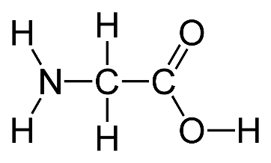

Astrochemistry: evolution of molecular complexity in space important role of Bertrand Lefloch
The basic questions of how, why and what molecular complexity is reached are still unanswered.
The way forward is to collect high resolution unbiased spectra covering the largest possible frequency range, in order to have the most complete census of the present species, towards the largest possible sample of sources representing the various phases the Solar System passed through.
Urea-clearly
detected
Glycine
Radio spectrum of Orion molecular cloud

Slide 21
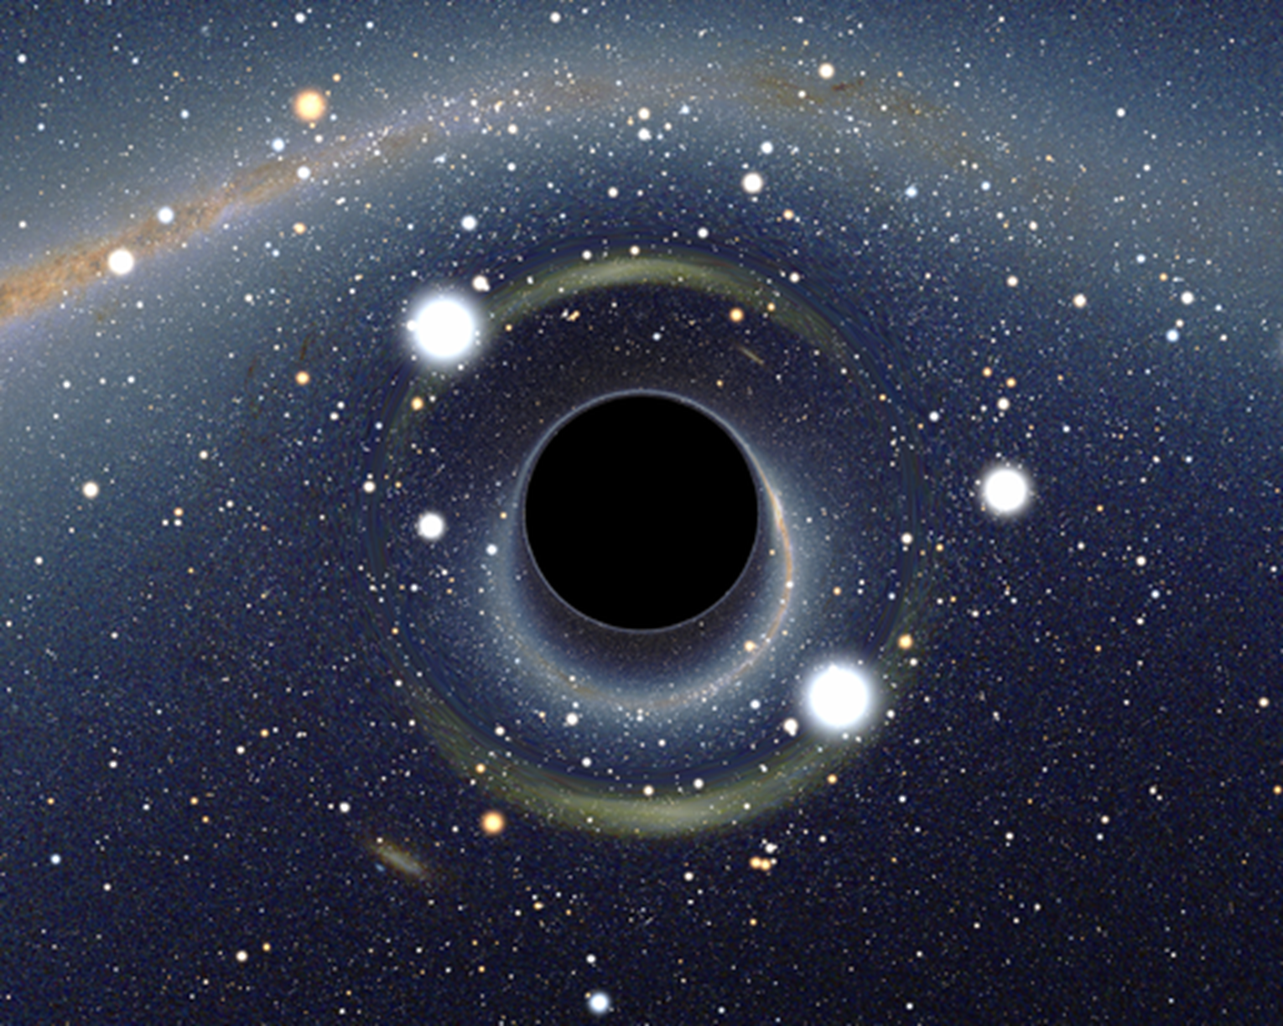
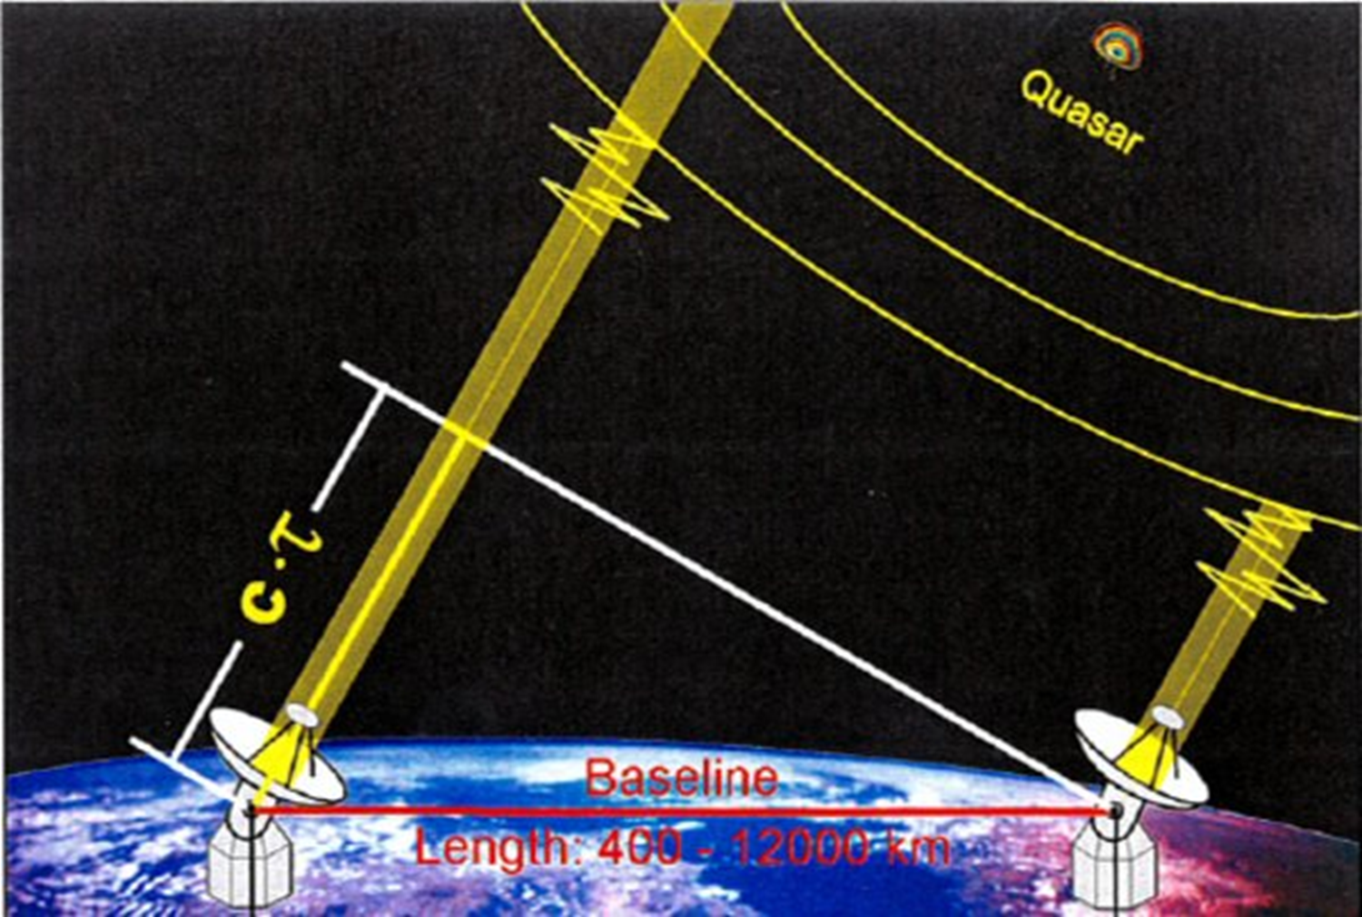
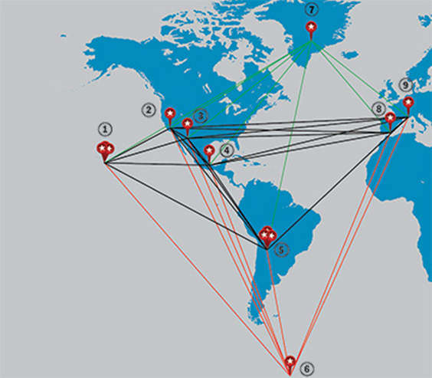
VLBI images
Black hole in the center of our Galaxy is the nearest
One. In principle with image resolution 0.03 mas
We could see the Event Horizon
Telescope separation 12000 km= 12x10⁹mm
Observation at 1 mm –resolution = 1rd/12x10⁹
= 0.017 mas Sgr A*
Einstein's theory of general relativity
predicts that there will be a roughly
circular "shadow" around a black hole.
We intend to be part of the EHV
Event Horizon Telescope

Slide 22
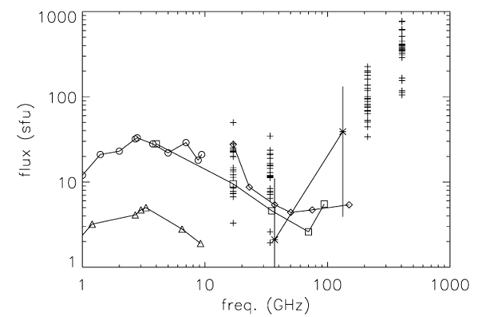
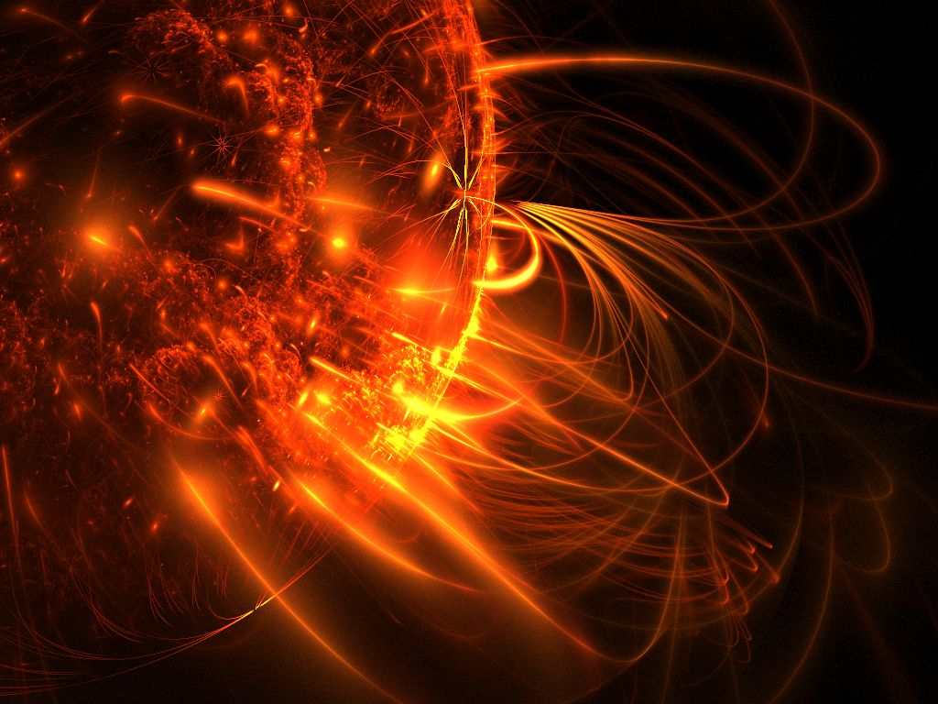
Solar Physics
LLAMA can extend the frequency coverage up to 1000 GHz with the addition of polarization information. Joint observations with SST (mostly 212 GHz), and the other patrol telescopes from 1 to 90 GHz will complete a spectrum with almost three orders in frequency
Simultaneous observations at different frequencies will be a plus of LLAMA for the observation of flares. We will be able to measure the delay between the maximum of a flare between frequencies, which is due to the propagation of radiation in the plasma
Comparison of submillimeter active region
Flux density spectra with previously
published data. From Silva et al. (2005)

Slide 23
