Slide 1
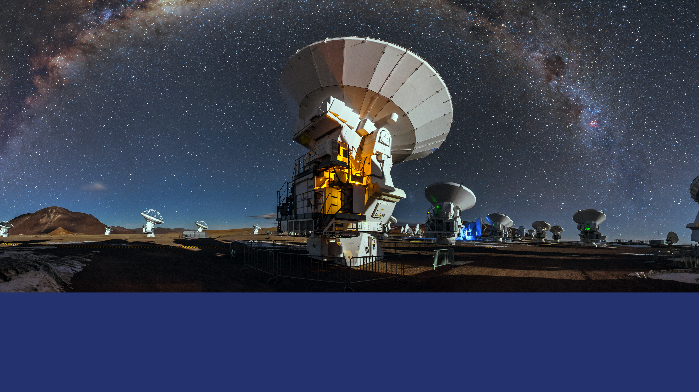
Radio Astronomy Universe
Thijs de Graauw

Slide 2
Topics
SKA
FRB
Mm arrays
VLBI
more

Slide 3
Bottom line
Radio Astronomy is getting stronger position in multiwavelength astronomy

Slide 4
SKA, is going to happen

Slide 6
Unrivaled Science Preparation

Slide 11
Fast Radio Bursts: Very Hot Topic
Fast Radio Burst (FRB) is a high-energy astrophysical phenomenon
- unknown origin
- manifested as a transient radio pulse lasting only a few milliseconds.
The first FRB was discovered by Duncan Lorimer and his student David Narkovic
in 2007 when they were looking through archival pulsar survey data of 2001
By now > …...
Bright, point-like, broad band, millisecond, repeating?

Slide 14
Detection and Frequency of Occurance of FRB’s
The upgraded (UTMOST),
(Australia), reports finding 3 more FRBs.
A 180-day 3 part survey in 2015 and 2016 found 3 FRBs at 843 MHz.^{[8]}
A short survey using part of ASKAP found one FRB in 3.4 days.
GBT 15 more
More archival work underway
Facilities used: a.o. Parkes, UTMOST, GBT, etc…
New facilities getting (soon) on line like CHIME. WSRT/Apertif/Arts, etc…
With better location, wider field/survey mode, ...
ORIGIN, astronomical, extra galactic?
A Fast Radio Burst Occurs Every Second throughout the Observable Universe"
by Anastasia Fialkov and Abraham Loeb

Slide 15
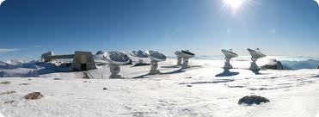
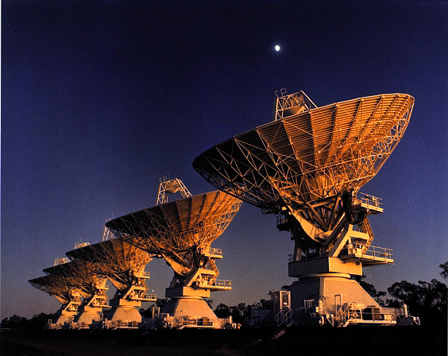
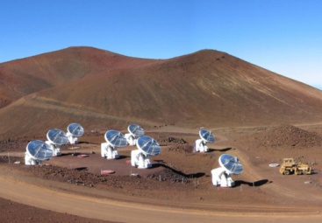
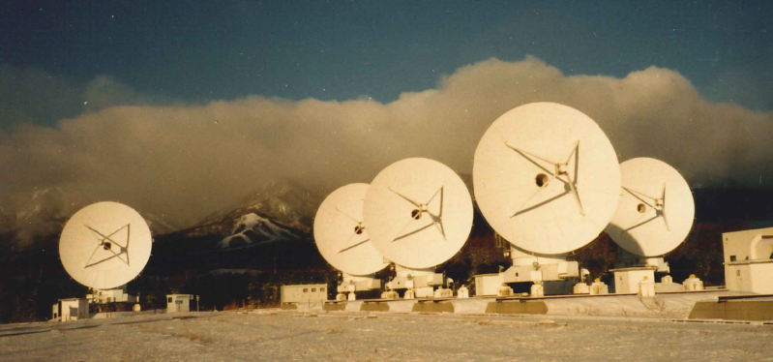
Submm/mm Interferometres; before 2011
IRAM PdB (NOEMA)
6 (12) antennas,
each 15 m in diameter
ATCA : 6 antennas each 22 m in diameter
Square Meters
SMA: 100
CARMA: 800
IRAM: 2100
ALMA: 6200
SMA
8 antennas each 6 meters in diameter
CARMA
6 Antennas each 10.4 m. in diameter. (OVRO)
9 Antennas each 6.1 m. (Hat Creek)
8 Antennas each 3.5 m. in diameter. (SZA)
NRO: 6 antennas each 10 metres in diameter

Slide 16
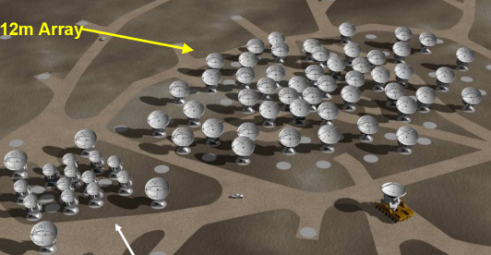
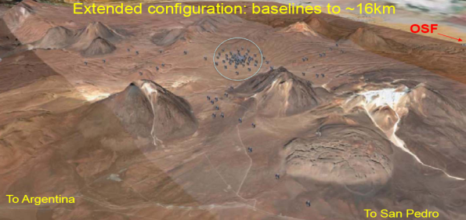
ALMA:
A partnership among Europe, North America and East Asia
(in cooperation with the Republic of Chile) to build and operate:
An array of 66 antennas, in aperture synthesis ,as a “zoom telescope”
compact
extended
At 5000m
Remotely operated from
OSFControl room
ALMA is presently the largest astronomical ground-based project
It started Early Science 30 September 2011, Inauguration March 2013
Now in full operations

Slide 17
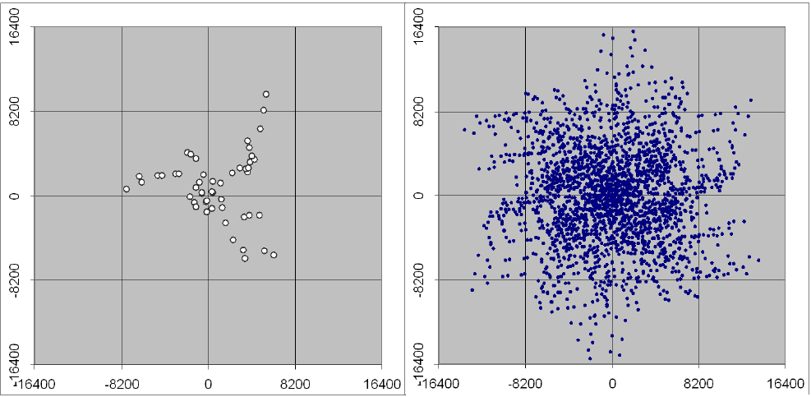
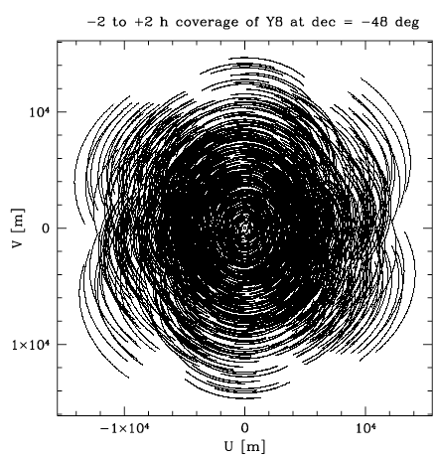
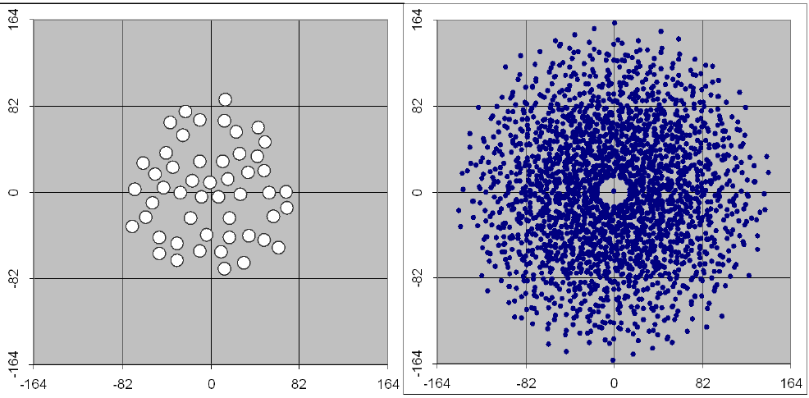
Most compact configuration – Left: Antennas, Right: snapshot UV coverage
ALMA: Baselines
Speed and Configurations
Most extended configuration – Note that scale is 100 x larger than on previous slide
UV coverage of most extended configuration, including earth rotation: 4 hours of observation

Slide 18
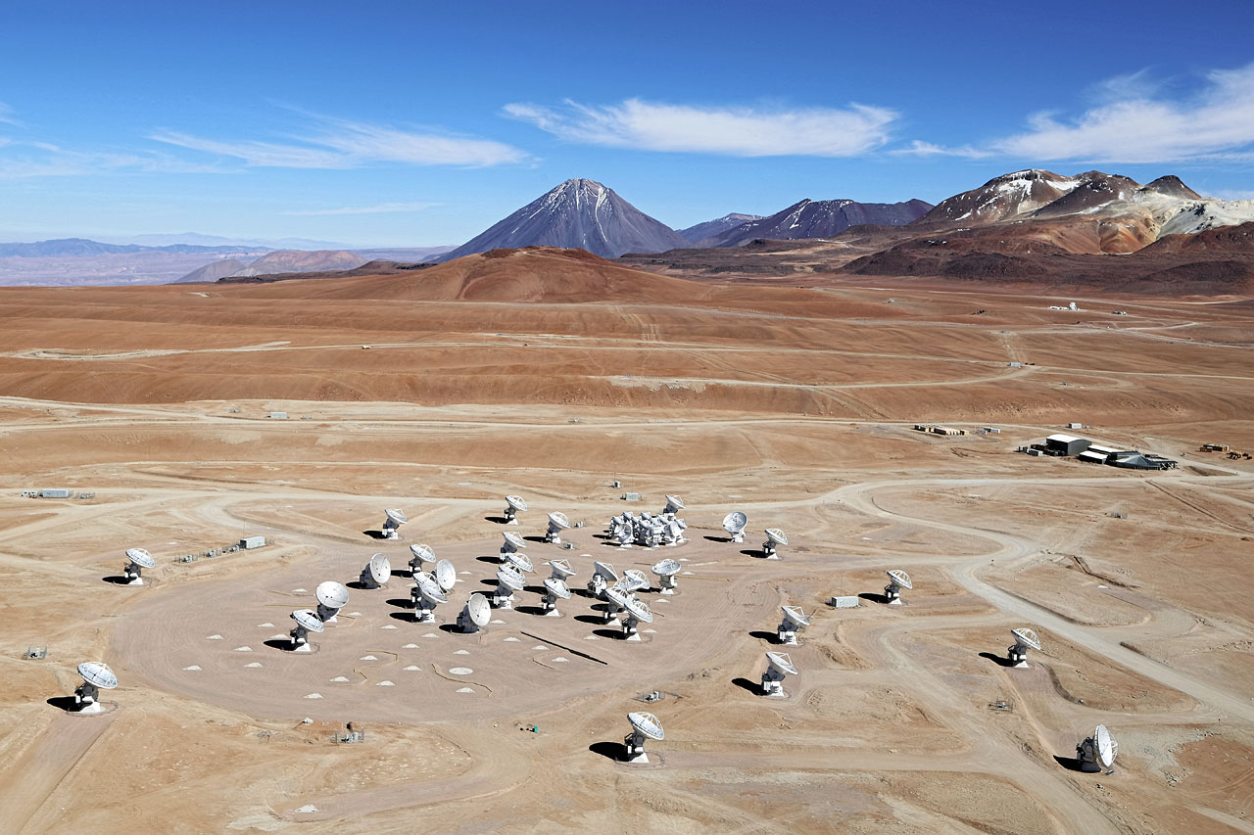

Slide 19
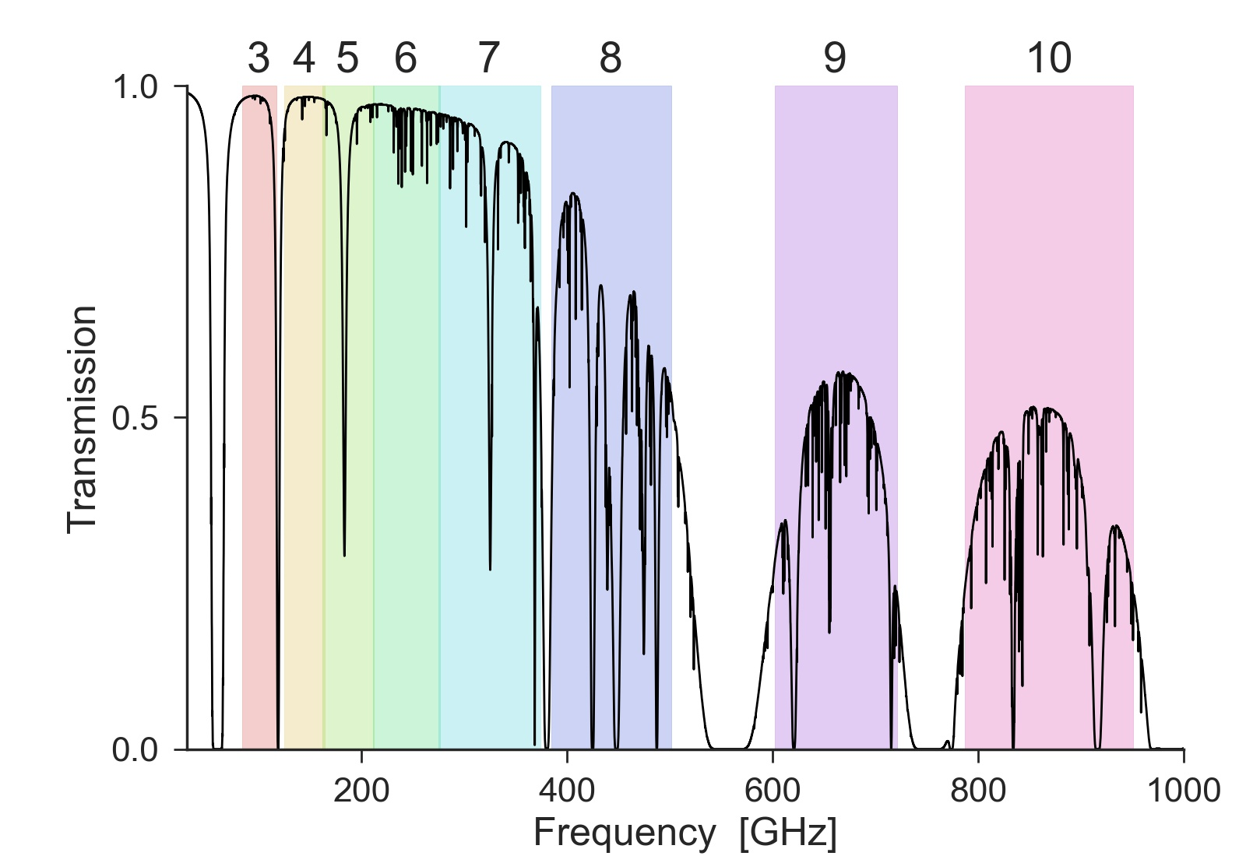
ALMA Frequency Bands

Slide 21
Proto Planetary Disks

Slide 22
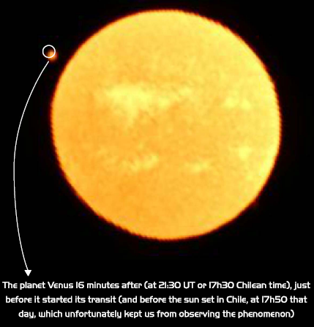
ALMA is a solar observatory!
Venus transit the sun

Slide 23
VLBI images products
EVN extensions and e-EVN
KVN and extensions
JVLA, etc..
ETH and GMVA
Conclusion

Slide 24
EVN
The telescopes involved in the successful detection of fringes during a VLBI test
experiment were part of the European VLBI Network (EVN) and
included: Badary Radio Astronomical Observatory (Institute of Applied Astronomy, Russia),
Effelsberg Radio Telescope (Max-Planck Institute for Radio Astronomy, Germany),
Hartebeesthoek Radio Astronomy Observatory (National Research Foundation, South Africa)
Jodrell Bank Observatory (University of Manchester, UK),
Medicina Radio Observatory (National Institute for Astrophysics, Italy),
Onsala Space Observatory (Chalmers University of Technology, Sweden),
Svetloe Radio Astronomical Observatory (Institute of Applied Astronomy, Russia),
Toruń Centre for Astronomy (Nicolaus Copernicus University, Poland),
Ürümqi Astronomical Observatory (Chinese Academy of Sciences, China),
Ventspils International Radio Astronomy Centre (Latvian Academy of Sciences, Latvia),
Westerbork Synthesis Radio Telescope (ASTRON, the Netherlands),
Yebes Observatory (National Geographic Institute, Spain), Zelenchukskaya Observatory (Institute of Applied Astronomy, Russia).
The telescopes involved in the successful detection of fringes during a VLBI test
experiment were part of the European VLBI Network (EVN) and included:
- Badary Radio Astronomical Observatory (Institute of Applied Astronomy, Russia),
- Effelsberg Radio Telescope (Max-Planck Institute for Radio Astronomy, Germany),
- Hartebeesthoek Radio Astronomy Observatory (National Research Foundation, South Africa)
- Jodrell Bank Observatory (University of Manchester, UK),
- Medicina Radio Observatory (National Institute for Astrophysics, Italy),
- Onsala Space Observatory (Chalmers University of Technology, Sweden),
- Svetloe Radio Astronomical Observatory (Institute of Applied Astronomy, Russia),
- Toruń Centre for Astronomy (Nicolaus Copernicus University, Poland),
- Ürümqi Astronomical Observatory (Chinese Academy of Sciences, China),
- Ventspils International Radio Astronomy Centre (Latvian Academy of Sciences, Latvia),
- Westerbork Synthesis Radio Telescope (ASTRON, the Netherlands),
- Yebes Observatory (National Geographic Institute, Spain),
- Zelenchukskaya Observatory (Institute of Applied Astronomy, Russia).

Slide 26
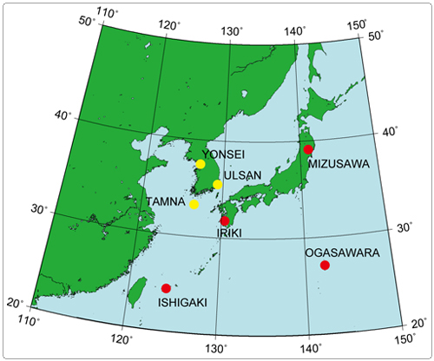
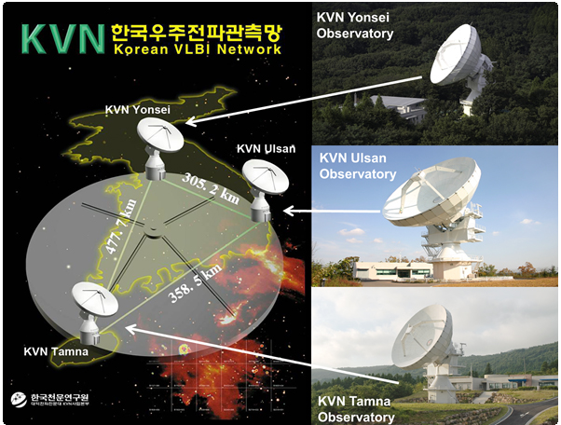
KVN (triple// frequency) and VERA

Slide 27
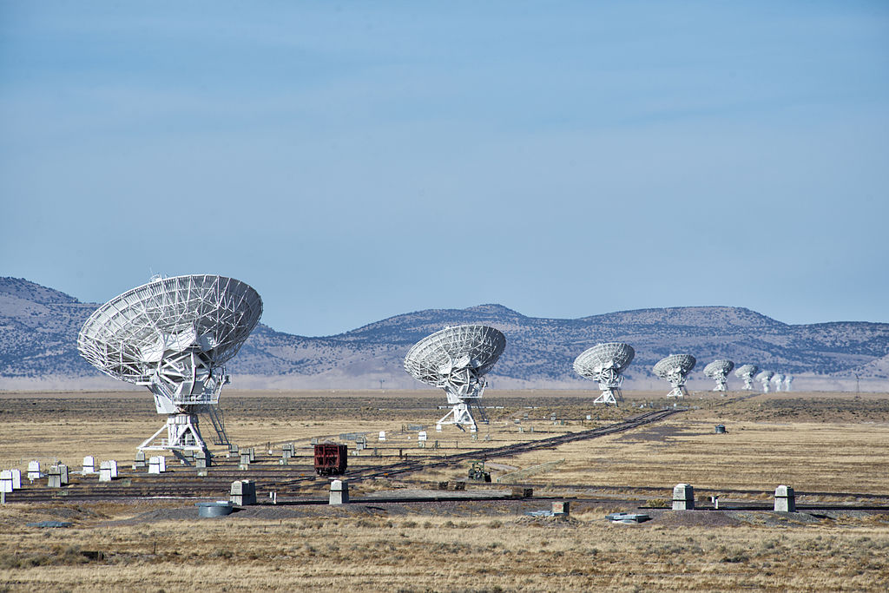
JVLA upgrade

Slide 28
VLBA

Slide 29
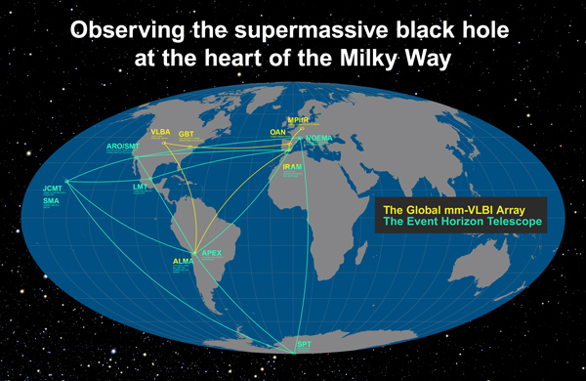
EHT and Global mm VLBI Array

Slide 30
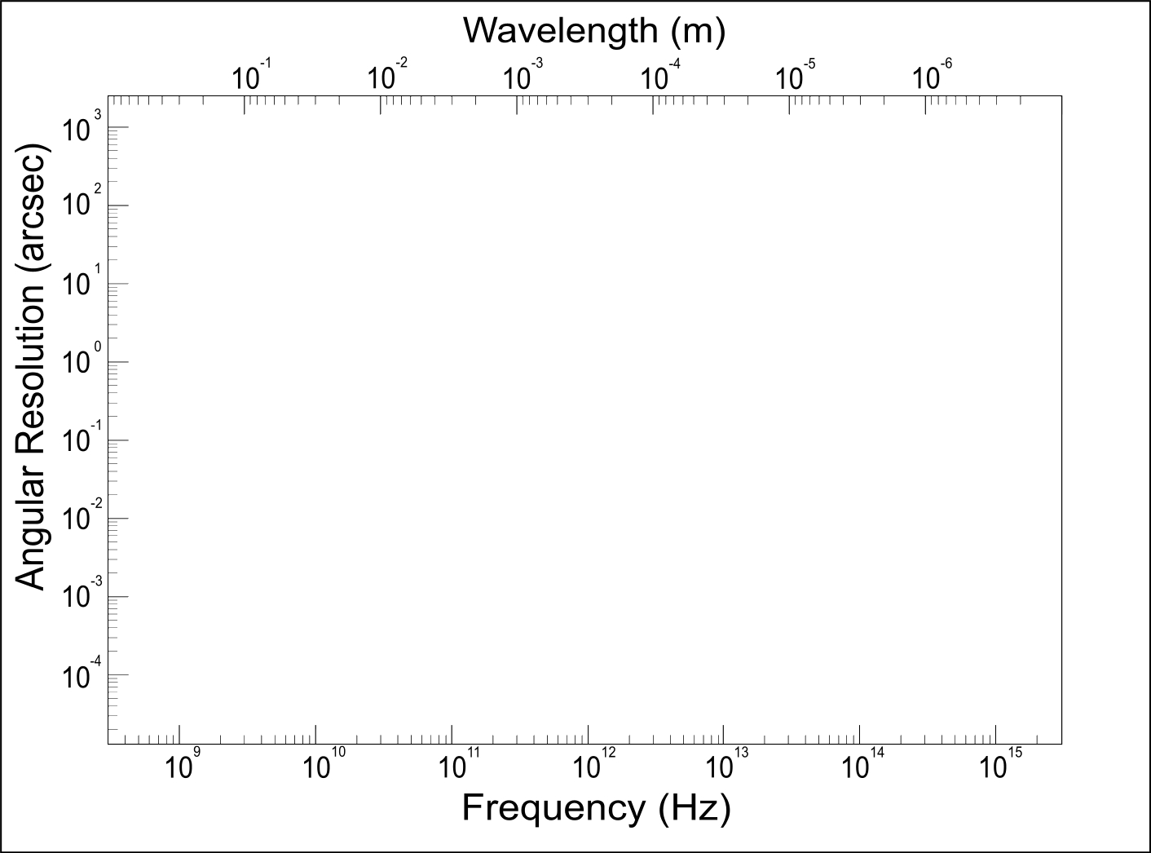
Situation in angular resolution capabolities
ATCA
Square Meters
SMA: 100
CARMA: 800
IRAM: 2100
ALMA: 6200
EVLA
GMRT
JCMT
SKA
IRAM
CARMA
SMA
ALMA
HERSCHEL
ISO
EVN
JWST
SPITZER
VLTI
HUBBLE
VLT
E-ELT
VLBA

Slide 31
Summary
SKA realisation phase-1 is imminent after 25 years of talking
ALMA has taken a strong role in transformational science
VLBI has gotten into high quality imaging thanks to coordination and increased (equipment and computing) facilities
Radio Astronomy is getting stronger position in multiwavelength astronomy

Slide 32
The African VLBI network
The SKA AVN partners of South Africa are: Botswana, Ghana, Kenya, Madagascar, Mauritius, Mozambique, Namibia, and Zambia.

Slide 33
AVN
Designed to do important science
A vital part of the effort towards building SKA on the African Continent
over the next decade is the African Very Long Baseline Interferometry (VLBI) Network
The recent annual SKA African Partner Countries Ministerial Meeting held in Pretoria,
provided political and strategic leadership to African SKA partner countries on the
AVN, SKA and other relevant astronomy programmes and initiatives.
The SKA AVN partners of South Africa are:
Botswana, Ghana, Kenya, Madagascar, Mauritius,
Mozambique, Namibia, and Zambia.

